Slide 1
Precision Farming
Task 1 Group A-1

Slide 2
The Software Part

Slide 3
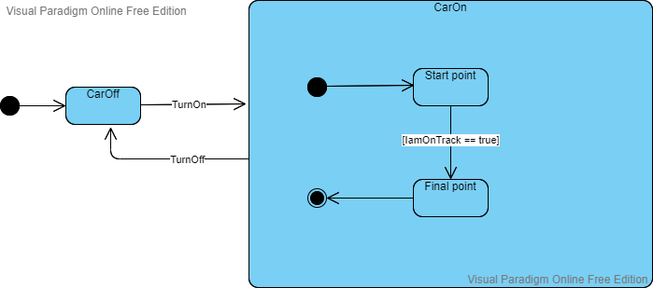
Software Engineering Diagrams
State Machine Diagram

Slide 4
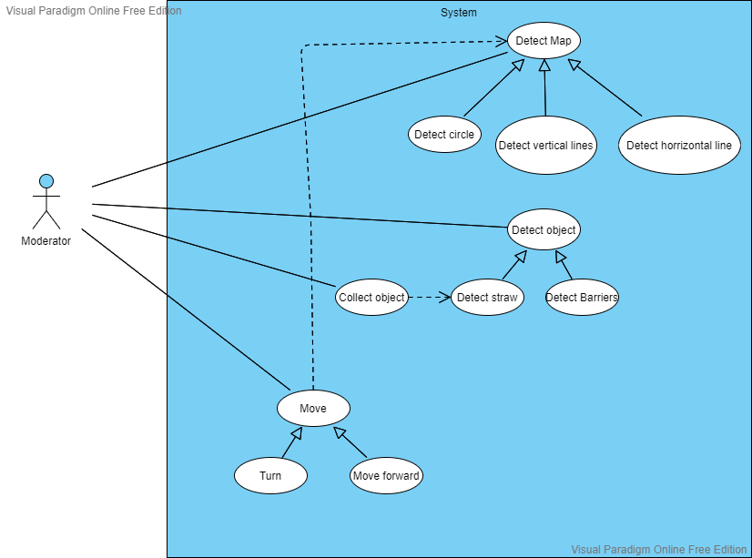
Software Engineering Diagrams
Use Case Diagram

Slide 5
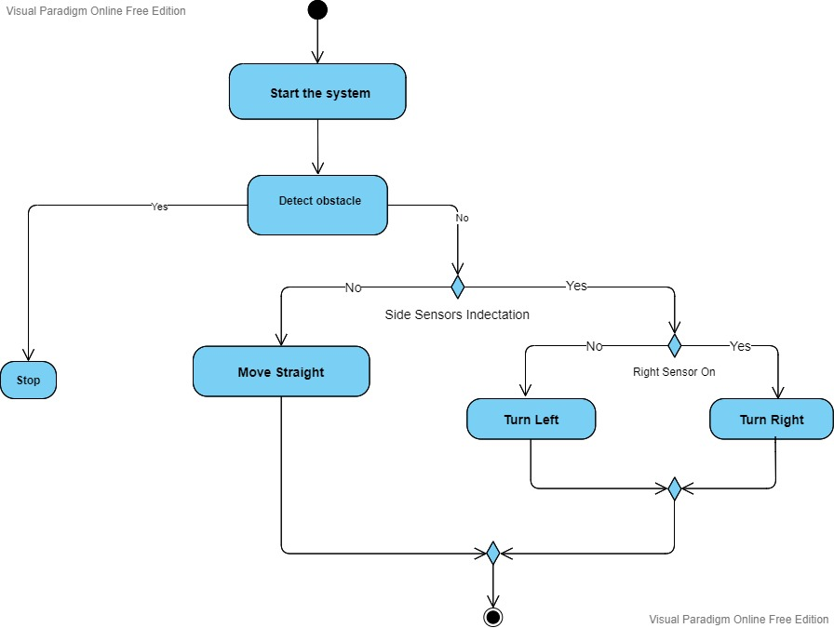
Software Engineering Diagrams
Activity Diagram

Slide 6
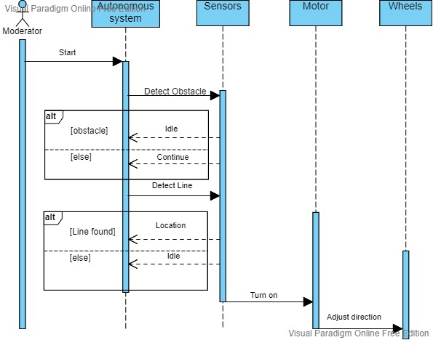
Software Engineering Diagrams
Sequence Diagram

Slide 7
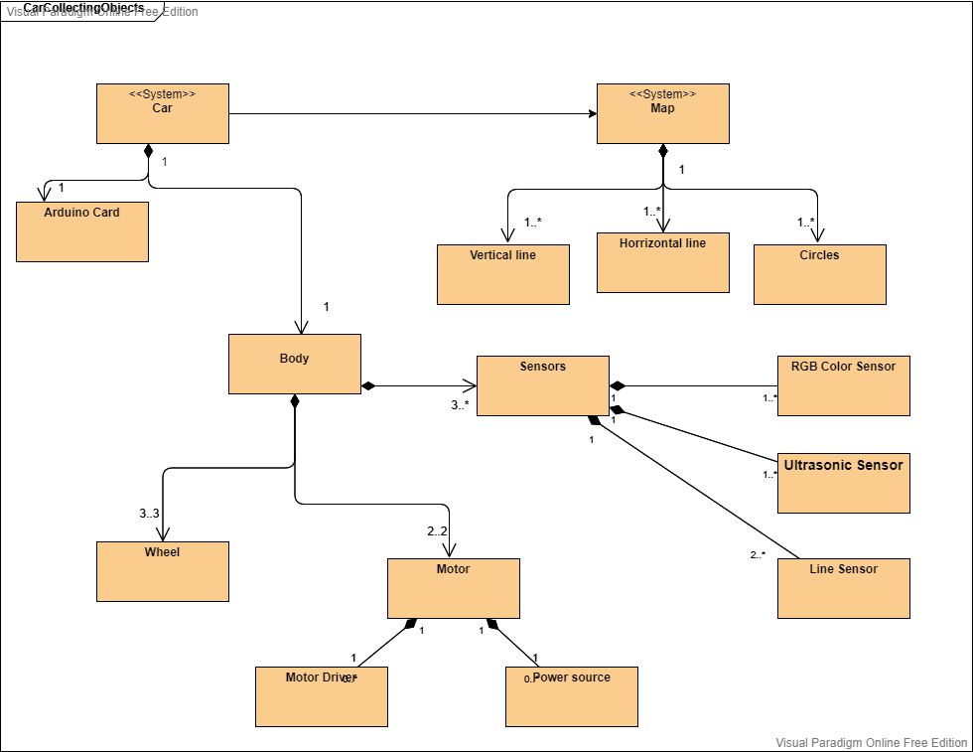
Software Engineering Diagrams
Block Diagram

Slide 8
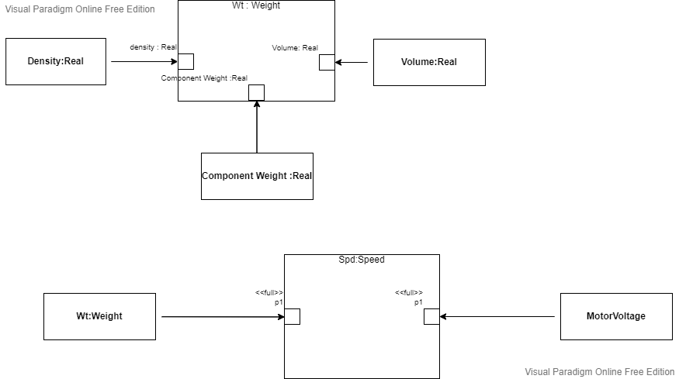
Software Engineering Diagrams
Parametric Diagram

Slide 9
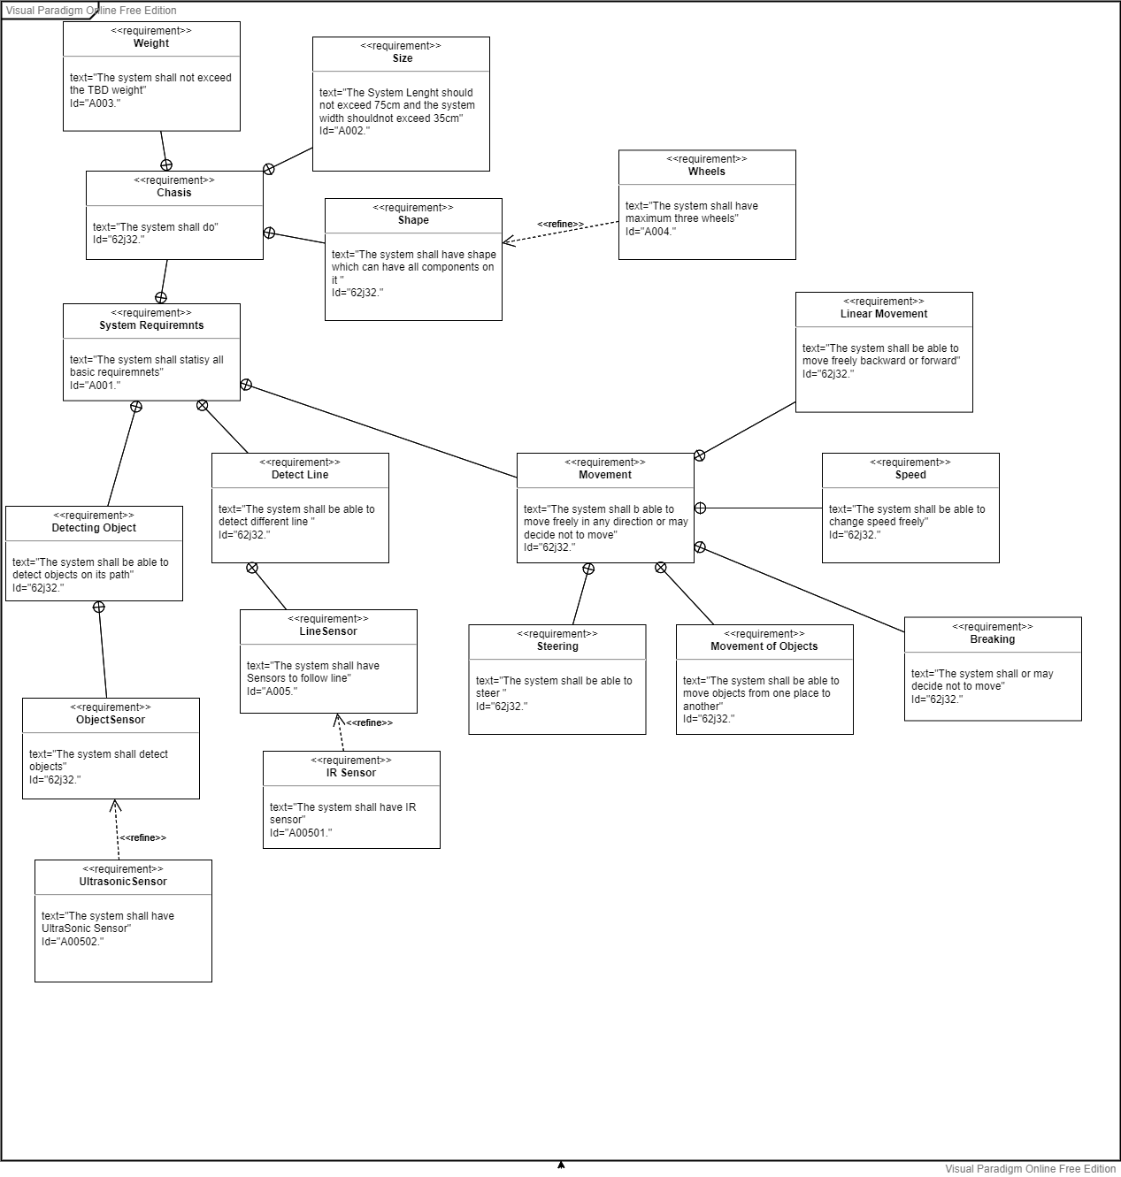
Software Engineering Diagrams
Requirement Diagram

Slide 10
The Implementation Part

Slide 11
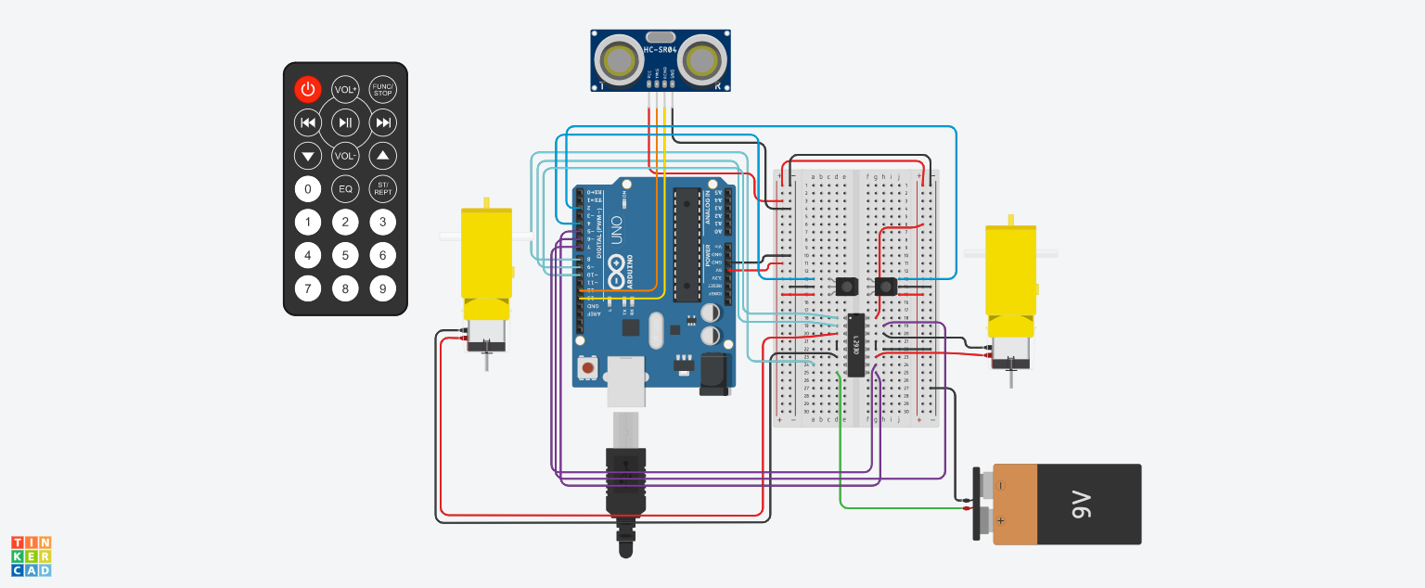
TinkerCad Simulation

Slide 12
Arduino Simulation
#define ln1 2
#define ln2 4
#define sonicTrig 12
#define sonicEcho 13
#define motor1A 6
#define motor1B 7
#define motor2A 9
#define motor2B 8
#define Forward 100
#define Right 110
#define Left 120
#define Stop 400
#define motorPowerA 10
#define motorPowerB 5
volatile int state = Forward;
void setup()
{
pinMode(ln1, INPUT);
pinMode(ln2,INPUT);
pinMode(sonicTrig,INPUT);
pinMode(sonicEcho,OUTPUT);
pinMode(motor1A,OUTPUT);
pinMode(motor1B,OUTPUT);
pinMode(motor2A,OUTPUT);
pinMode(motor2B,OUTPUT);
analogWrite(motorPowerA, 255);
analogWrite(motorPowerB, 255);
Serial.begin(9600);
}

Slide 13
Arduino Simulation
void sonicSensor(){
int duration;
int distance;
digitalWrite(sonicTrig,HIGH);
digitalWrite(sonicTrig,LOW);
duration = pulseIn(sonicEcho,HIGH);
distance = duration*0.0343/2;
Serial.println(distance);
if (distance < 5){state = Stop;}
}
void loop()
{
if(digitalRead(ln1)==HIGH && digitalRead(ln2)==HIGH){
state = Stop;
}
if(digitalRead(ln1)==HIGH && digitalRead(ln2)==LOW){
//find motor config to make it turn RIGHT
state = Left;
}
if(digitalRead(ln1)==LOW && digitalRead(ln2)==HIGH){
//find motor config to make it turn LEFT
state = Right;
}
if(digitalRead(ln1)==LOW && digitalRead(ln2)==LOW){
state = Forward;
}
switchState();
sonicSensor();
}

Slide 14
Arduino Simulation
void switchState(){
switch(state){
case Stop:
digitalWrite(motor1A,LOW);
digitalWrite(motor1B,LOW);
digitalWrite(motor2A,LOW);
digitalWrite(motor2B,LOW);
break;
case Forward:
analogWrite(motorPowerA,255);
analogWrite(motorPowerA,255);
digitalWrite(motor1A,HIGH);
digitalWrite(motor1B,LOW);
digitalWrite(motor2A,LOW);
digitalWrite(motor2B,HIGH);
break;
case Right:
analogWrite(motorPowerA,120);
analogWrite(motorPowerB,120);
digitalWrite(motor1A,HIGH);
digitalWrite(motor1B,LOW);
digitalWrite(motor2A,HIGH);
digitalWrite(motor2B,LOW);
break;
case Left:
analogWrite(motorPowerA,120);
analogWrite(motorPowerB,120);
digitalWrite(motor1A,LOW);
digitalWrite(motor1B,HIGH);
digitalWrite(motor2A,LOW);
digitalWrite(motor2B,HIGH);
break;
}
}

Slide 15
Thank You For Your Attention

